Slide 1
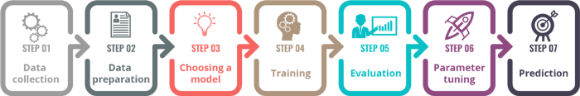
Seven Steps in ML

Slide 2
DATA

Slide 3
Different Types of DATA
Since an important component of the machine learning process is data storage, we briefly consider in this section the different types and forms of data that are encountered in the machine learning process.
Unit of observation
By a unit of observation we mean the smallest entity with measured properties of interest for a study.
Examples
A person, an object or a thing
A time point
A geographic region
A measurement
Sometimes, units of observation are combined to form units such as person-years.

Slide 4
Examples and Features
Datasets that store the units of observation and their properties can be imagined as collections of data consisting of the following:
Examples
An “example” is an instance of the unit of observation for which properties have been recorded.
An “example” is also referred to as an “instance”, or “case” or “record.”

Slide 5
Examples and Features
Features
A “feature” is a recorded property or a characteristic of examples. It is also referred to as “attribute”, or “variable” .

Slide 6
Examples for “examples” and “features”
1.Cancer detection
Consider the problem of developing an algorithm for detecting cancer. In this study we note
the following.
(a) The units of observation are the patients.
(b) The examples are members of a sample of cancer patients.
(c) The following attributes of the patients may be chosen as the features:
gender
age
blood pressure
the findings of the pathology report after a biopsy

Slide 7
Examples for “examples” and “features”
Spam e-mail
Let it be required to build a learning algorithm to identify spam e-mail.
(a) The unit of observation could be an e-mail messages.
(b) The examples would be specific messages.
(c) The features might consist of the words used in the messages.

Slide 8
DATA SET
Examples and features are generally collected in a matrix format.

Slide 9
Different forms of data
1. Numeric data
2. Categorical or nominal
3. Ordinal data

Slide 10
Different forms of data
Numeric Data
If a feature represents a characteristic measured in numbers, it is called a numeric feature.
Categorical or norminal Data
A categorical feature is an attribute that can take on one of a limited, and usually fixed, number of possible values on the basis of some qualitative property. A categorical feature is also called a nominal feature.

Slide 11
Different types of Data
Ordinal Data
This denotes a nominal variable with categories falling in an ordered list. Examples include clothing sizes such as small, medium, and large, or a measurement of customer satisfaction on a scale from “not at all happy” to “very happy.”

Slide 12
In the data given in Fig.1.2, the features “year”, “price” and “mileage” are numeric and the features “model”, “color” and “transmission” are categorical.

Slide 13
Examples of ML Applications

Slide 14
General classes of machine learning problems
Learning Associations
Classification
Regression

Slide 15
Learning Associations
Association rule learning is a machine learning method for discovering interesting relations, called “association rules”, between variables in large databases using some measures of “interestingness”.

Slide 16
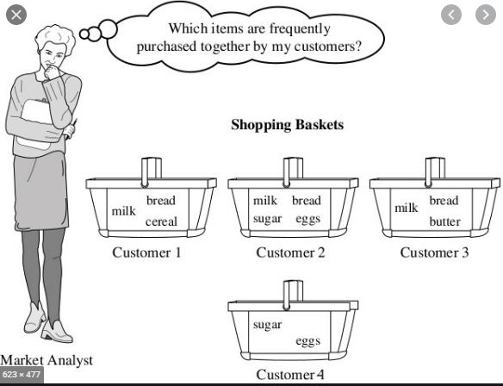
Market Basket Analysis

Slide 17
Example
Consider a supermarket chain. The management of the chain is interested in knowing whether there are any patterns in the purchases of products by customers like the following:
“If a customer buys onions and potatoes together, then he/she is likely to also buy hamburger.”
This defines an association between the set of products {onion, potato} and the set {burger}. This association is represented in the form of a rule as follows:
{onion, potato} {burger}

Slide 18
The measure of how likely a customer, who has bought onion and potato, to buy burger also is given by the conditional probability
P({burger}|{onion, potato});
If this conditional probability is 0.8, then the rule may be stated more precisely as follows:
“80% of customers who buy onion and potato also buy burger.”

Slide 19
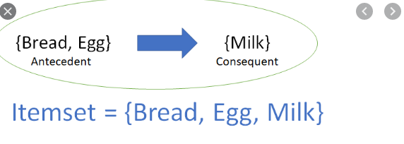
Association Rule
Consider an association rule of the form
X =>Y;
that is, if people buy X then they are also likely to buy Y .
Suppose there is a customer who buys X and does not buy Y . Then that customer is a potentialY customer.
Once we find such customers, we can target them for cross-selling. A knowledge of such rules can be used for promotional pricing or product placements.

Slide 20
Association Rule
In finding an association rule X Y , we are interested in learning a conditional probability of the form P(Y |X) where Y is the product the customer may buy and X is the product or the set of products the customer has already purchased.

Slide 21
Algorithms Used for Learning Associations
There are several algorithms for generating association rules. Some of the well-known algorithms are listed below:
a) Apriori algorithm
c) FP-Growth Algorithm (FP stands for Frequency Pattern)

Slide 22


Classification

Slide 23
Classification
In machine learning, classification is the problem of identifying to which of a set of categories a new observation belongs, on the basis of a training set of data containing observations (or instances) whose category membership is known.

Slide 24
Example

Slide 25
Example
If we have some new data, say “Score1 = 25” and “Score2 = 36”, what value should be assigned to “Result” corresponding to the new data;
to which of the two categories or classes the new observation should be assigned?

Slide 26
To answer this question, using the given data alone we need to find the rule, or the formula, or the method that has been used in assigning the values to the class label “Result”.
The problem of finding this rule or formula or the method is the classification problem.

Slide 27
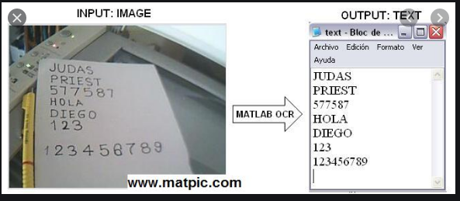
Real life examples
Optical Character Recognition.
Optical character recognition problem, which is the problem of recognizing character codes from their images, is an example of classification problem.

Slide 28
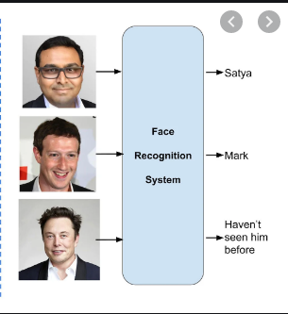
Face Recognition
In the case of face recognition, the input is an image, the classes are people to be recognized,and the learning program should learn to associate the face images to identities.

Slide 29

Speech recognition
In speech recognition, the input is acoustic and the classes are words that can be uttered.

Slide 30
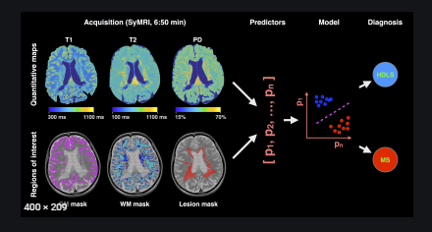
Medical diagnosis
In medical diagnosis, the inputs are the relevant information we have about the patient and the classes are the illnesses.

Slide 31
Discriminant
A discriminant of a classification problem is a rule or a function that is used to assign labels to new observations.
Consider a finance company which lends money to customers. Before lending money, the company would like to assess the risk associated with the loan. For simplicity, let us assume that the company assesses the risk based on two variables, namely, the annual income and the annual savings of the customers.
Let x1 be the annual income and x2 be the annual savings of a customer.. After using the past data, a rule of the following form with suitable values for 1 and 2 may be formulated:
IF x1 > 1 AND x2 > 2 THEN “low-risk” ELSE “high-risk”.

Slide 32
Examples of machine learning algorithms for classification.
a)Logistic regression
b) Naive Bayes algorithm
c) k-NN algorithm
d) Decision tree algorithm
e) Support vector machine algorithm
f) Random forest algorithm

Slide 33
Classification
A classification problem requires that examples be classified into one of two or more classes.
A classification can have real-valued or discrete input variables.
A problem with two classes is often called a two-class or binary classification problem.
A problem with more than two classes is often called a multi-class classification problem.
A problem where an example is assigned multiple classes is called a multi-label classification problem.

Slide 34
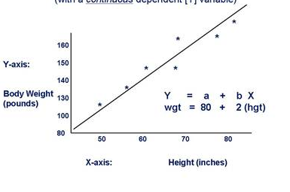
Regression
In machine learning, a regression problem is the problem of predicting the value of a numeric variable based on observed values of the variable.
The value of the output variable may be a number,such as an integer or a floating point value. These are often quantities, such as amounts and sizes.
The input variables may be discrete or real-valued.

Slide 35
Example
Suppose we are required to estimate the price of a car aged 25 years with distance 53240 KM and weight 1200 pounds.
This is an example of a regression problem beause we have to predict the value of the numeric variable “Price”.

Slide 36
General Approach
Let x denote the set of input variables and y the output variable.
In machine learning, the general approach to regression is to assume a model, that is, some mathematical relation between x and y,involving some parameters say,Θ , in the following form:
y = f(x, Θ )
The function f(x,Θ) is called the regression function.
The machine learning algorithm optimizesthe parameters in the set such that the approximation error is minimized;
that is, the estimates of the values of the dependent variable y are as close as possible to the correct values given in thetraining set.
X is the independent variable and Y is the dependent variable

Slide 38
Different Regression Models
Simple linear regression
Multivariate linear regression
Polynomial Regression
Logistic Regression

Slide 39
Simple linear regression: There is only one continuous independent variable x and the assumed relation between the independent variable and the dependent variable y is
y = a + bx:

Slide 40
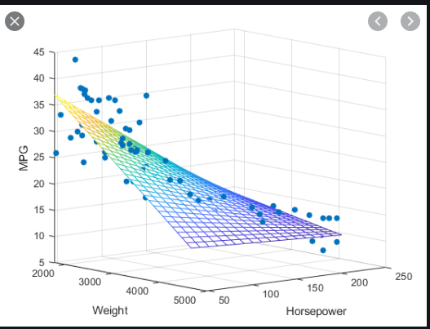
Multivariate linear regression
There are more than one independent variable, say x1; : : : ; xn,
and the assumed relation between the independent variables and the dependent variable is
y = a₀ + a₁x₁ +........+ a_{n}x_{n}:

Slide 41
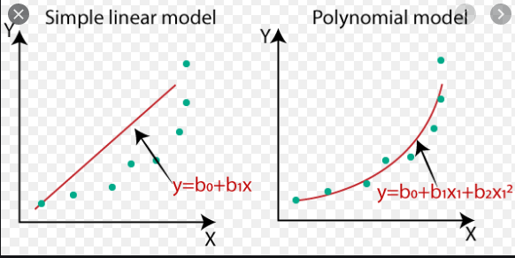
Polynomial Regression
There is only one continuous independent variable x and the assumed model is
y = a₀ + a₁x +....+ a_{n}x^{n}:

Slide 42
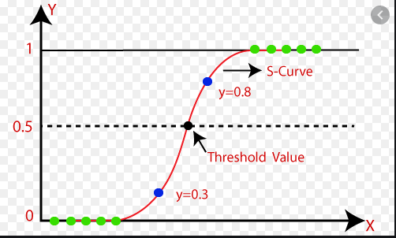
Logistic Regression
The dependent variable is binary, that is, a variable which takes only the values 0 and 1

